Slide 1
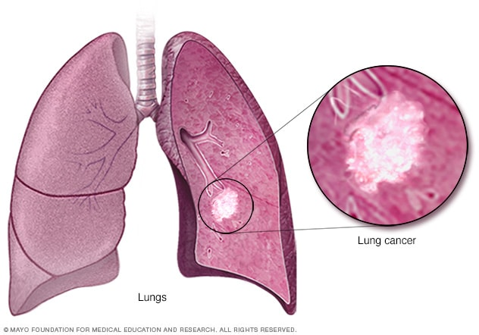
Analysis of Lung Cancer Incidence, Mortality and Risk Factors in the United States
Group 3

Slide 2
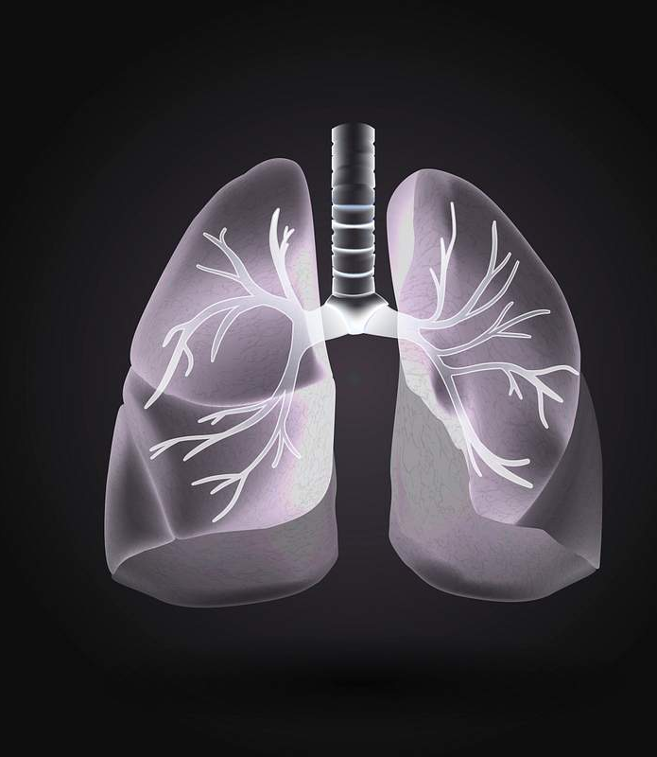
HDS 5230-05 High Performance Computing and Health Artificial Intelligence Instructor : Prof . Bahareh Rahmani Group : 03
Group Members :
Dr. Pala Jijol Onesimos – Resident Doctor (MD.FCCM.)
Shreya Shrestha – Public Health Practitioner
Dhwani Mehta – Biotechnologist
Sahil Patel - Chemist
Sohil Chaudhary - Registered Nurse

Slide 3
Table of Contents
Project Definition
Data Definition
Data Sources
Data Collection
Data Description
Data Attributes
Regression Profiling
Performance Comparison

Slide 4
Project Definition
Project Objective:
This project aims to analyze county-level lung cancer mortality and incidence in the United States. Linear regression is used to identify key predictors associated with mortality outcomes, and performance profiling is applied to evaluate computational efficiency in regression modeling.
Problem Statement:
Lung cancer continues to be a major public health concern in the United States, with substantial variation in outcomes across counties and populations.

Slide 5

Data Definition
Data consists of population-level, aggregated health records related to lung cancer.
Each dataset represents county-level measurements across multiple years.
Variables include cancer outcomes, geographic identifiers, and risk indicators.
Data is structured in CSV (.csv) format, suitable for statistical and machine learning analysis.

Slide 6
Data Description
The dataset contains aggregated, county-level lung cancer incidence and mortality records across the United States, with each observation representing a county for a given year.
Variables include cancer outcome measures, geographic identifiers, and selected behavioral risk indicators such as smoking prevalence.
All data were obtained from publicly available government sources and provided in CSV (.csv) format for statistical and regression analysis.

Slide 7
Data Collection Method
Data were collected from official U.S. cancer surveillance systems.
County-level datasets were downloaded directly from public data portals.
Data files were obtained in CSV format for reproducibility.
No personal identifiers are included, ensuring ethical data use.

Slide 8
Unit of Observation and Data Coverage
Unit of Observation: Each row represents a county–year combination.
Geographic Coverage: United States (county-level data).
Time Coverage: Multiple recent years (varies by dataset).
Population: Adult population in the United States.

Slide 9
Data Attributes
Geographic and Time Variables
county_fips – County identification code
state_name – U.S. state
county_name – County name
year – Year of observation
Outcome Variables
lung_cancer_incidence_rate
lung_cancer_mortality_rate
Risk and Screening Variables
smoking_prevalence
screening_indicator
Behavioral risk measures (e.g., smoking-related metrics)

Slide 10
Data Format
File format: CSV (.csv)
Rows represent county-level observations
Columns represent lung cancer outcomes, geographic identifiers, and risk factors
Data can be analyzed using:
Python (Pandas)
R
Excel
Statistical and machine learning tools

Slide 11

REGRESSION PROFILING

Slide 12
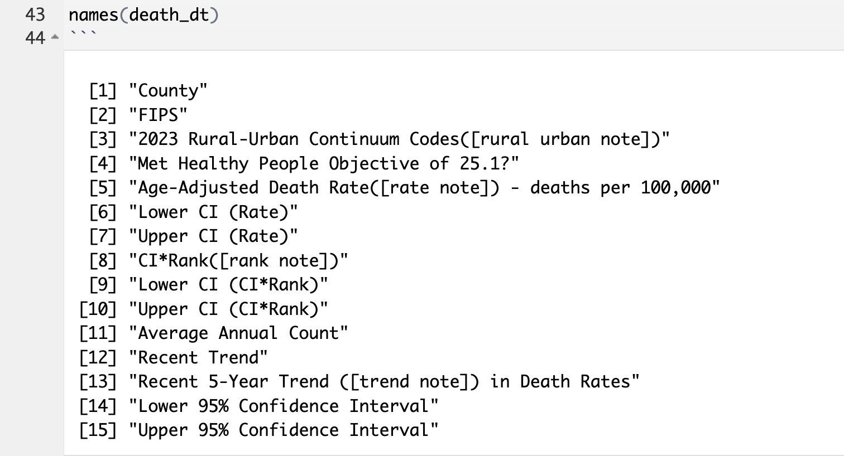
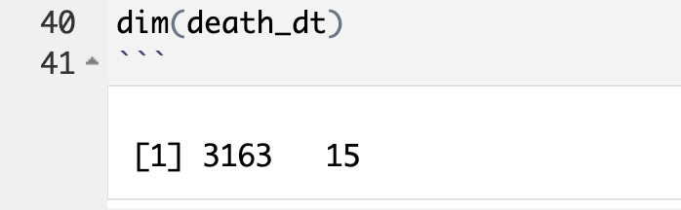
Step 1: Data Loading
Loaded lung cancer mortality county-level dataset and inspected structure.

Slide 13
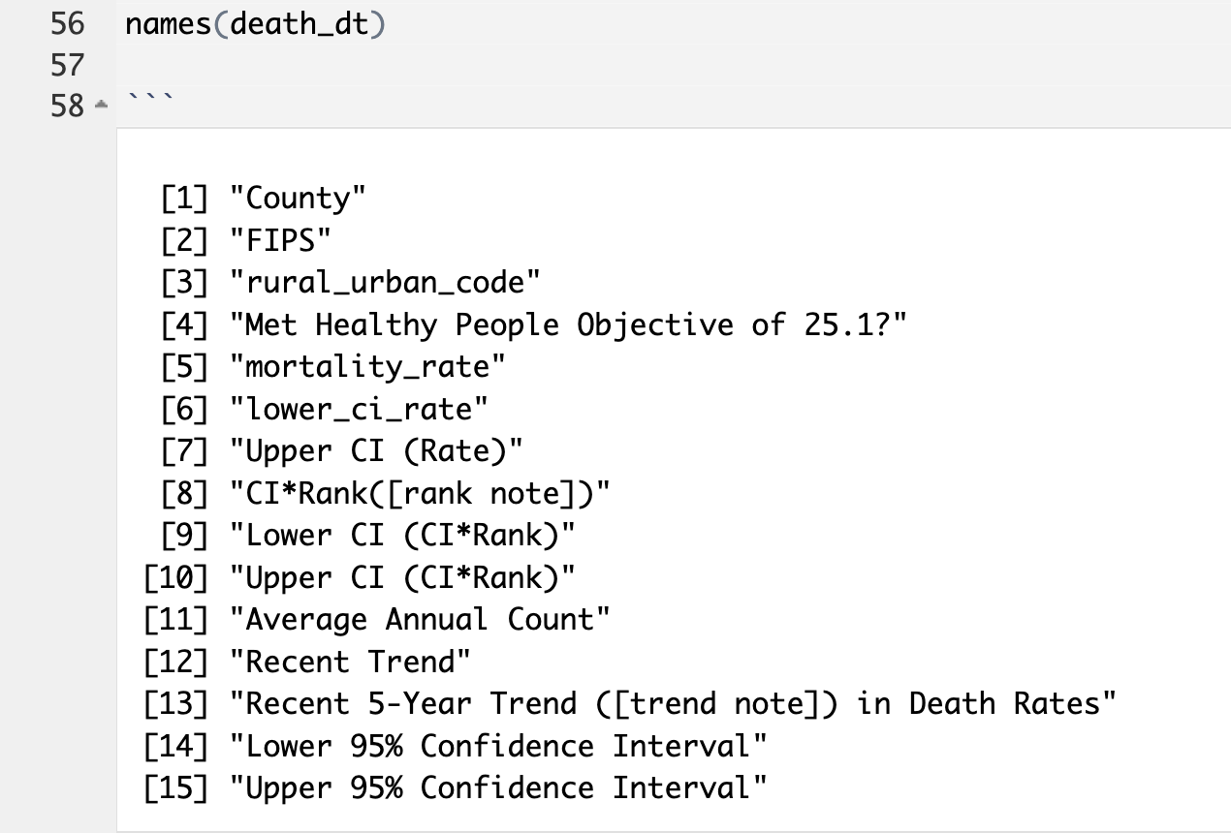
Step 2: Rename Columns
Renamed variables for consistent modeling and reproducibility.
names(death_dt) showing
mortality_rate,
rural_urban_code,
lower_ci_rate

Slide 14
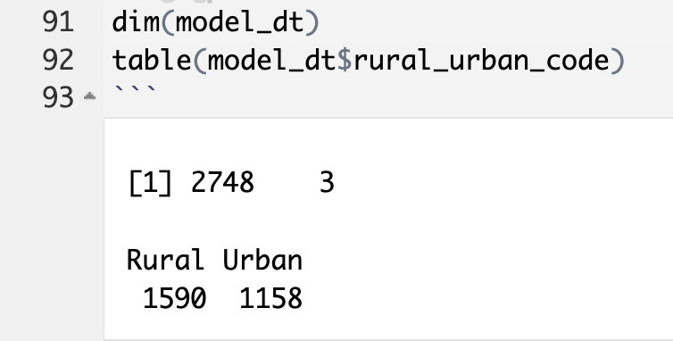
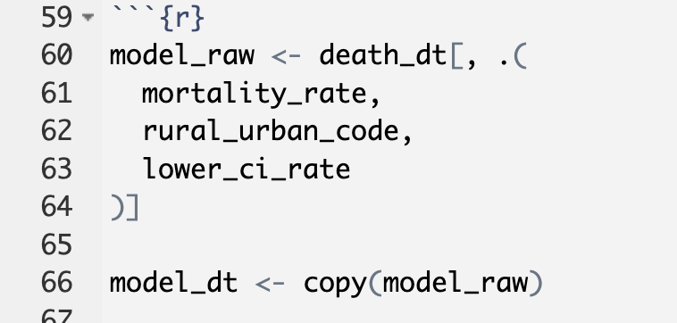
Step 3: Feature selection + cleaning
Selected outcome (mortality_rate) and predictors (rural/urban category and lower CI rate); removed missing values.

Slide 15
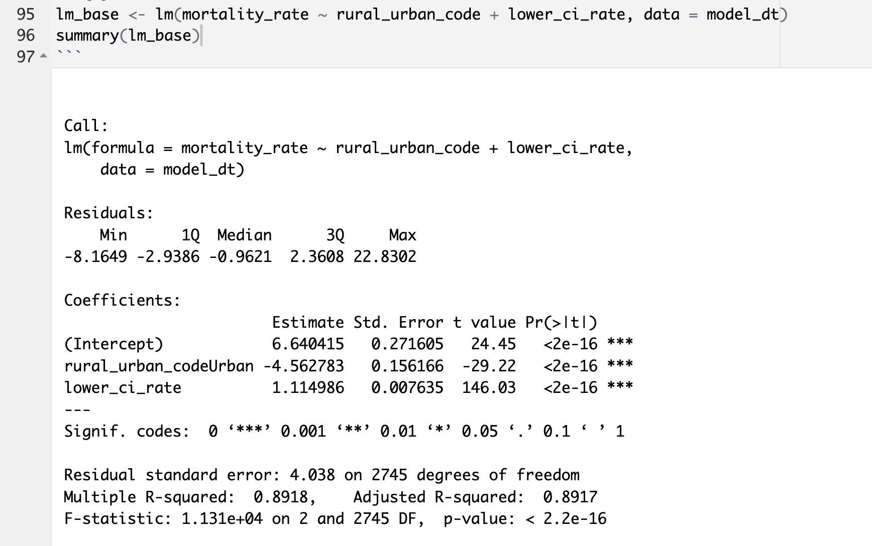
Step 4: Linear regression results
Fit linear regression to evaluate associations with lung cancer mortality.

Slide 16
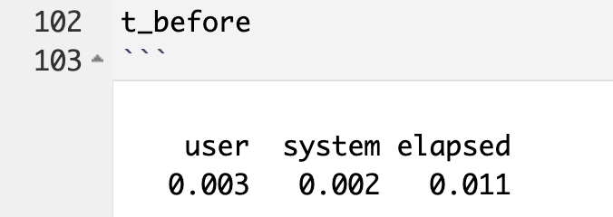
Step 5: Runtime before profiling
Measured baseline runtime of linear regression.
Baseline runtime measured using default data-loading method.

Slide 17
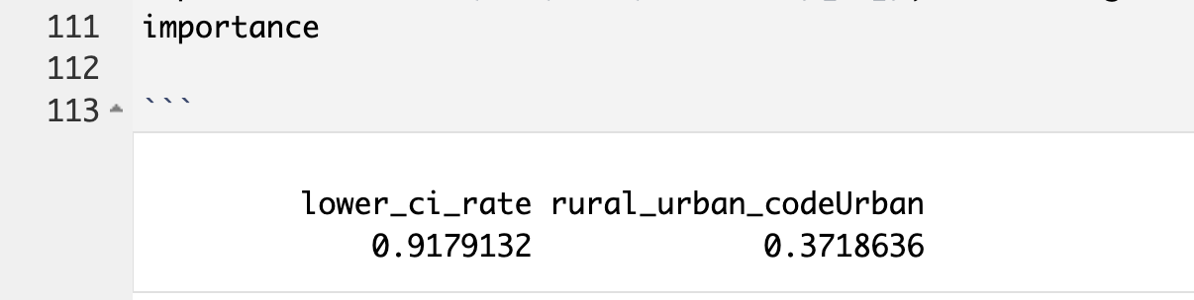
Step 6: Feature importance
Estimated feature importance using standardized regression coefficients.

Slide 18
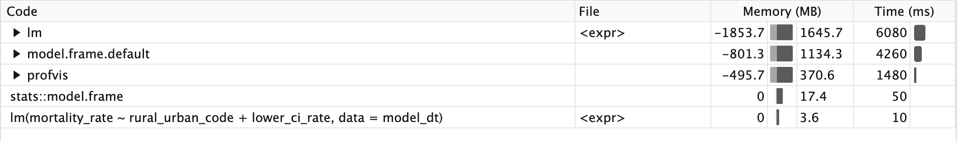
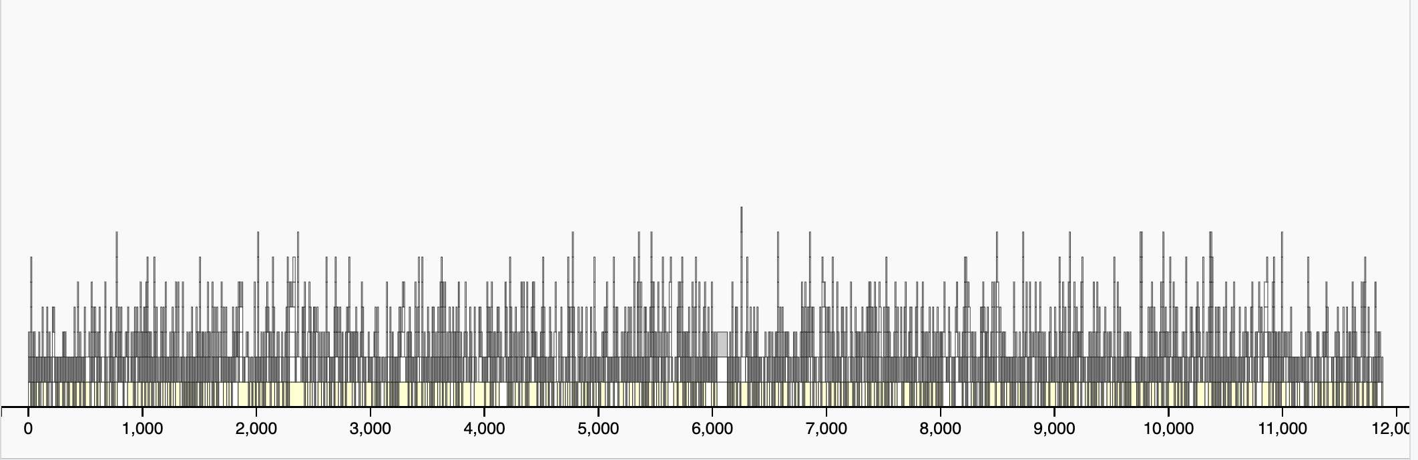
Step 7: Profiling results Flame Graph and Data tab
Profiled repeated model execution to identify time-consuming functions and performance bottlenecks.

Slide 19
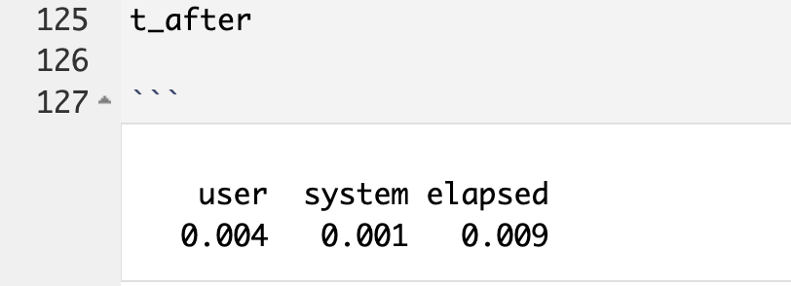
Step 8: Runtime after Profiling
Re-measured runtime after profiling for comparison.

Slide 20
Runtime Comparison: read.csv vs fread
Linear regression was executed using both read.csv() and fread() for data loading.
The fread() method demonstrated lower runtime compared to read.csv().
Faster data ingestion contributed to improved overall model execution time.

Slide 21
Conclusion :
The fread() method outperformed read.csv() in terms of data-loading speed and overall runtime efficiency.
When combined with profiling techniques, fread() proved to be more suitable for large public health datasets and high-performance computing workflows.

Slide 22

Performance Analysis of Random Forest Models Before and After Dask Parallelization

Slide 23
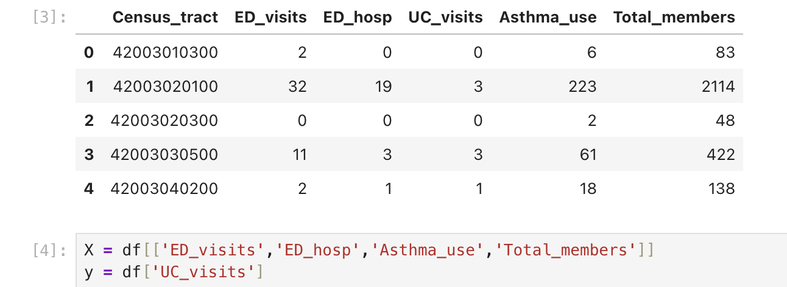
Feature Selection
Predictor variables:
ED_visits
ED_hosp
Asthma_use
Total_members
Target variable:
UC_visits

Slide 24
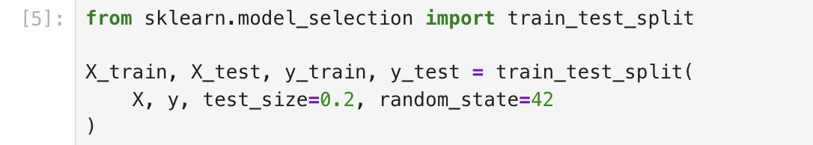
Data Splitting
The dataset was split into training and testing sets.
Training data: 80%
Testing data: 20%

Slide 25
Random Forest Before Parallelization
The Random Forest model was trained sequentially using a single processor to establish baseline runtime performance.
Serial times :
[0.052306175231933594, 0.037811994552612305, 0.012962102890014648, 0.011115789413452148, 0.018572092056274414]

Slide 26
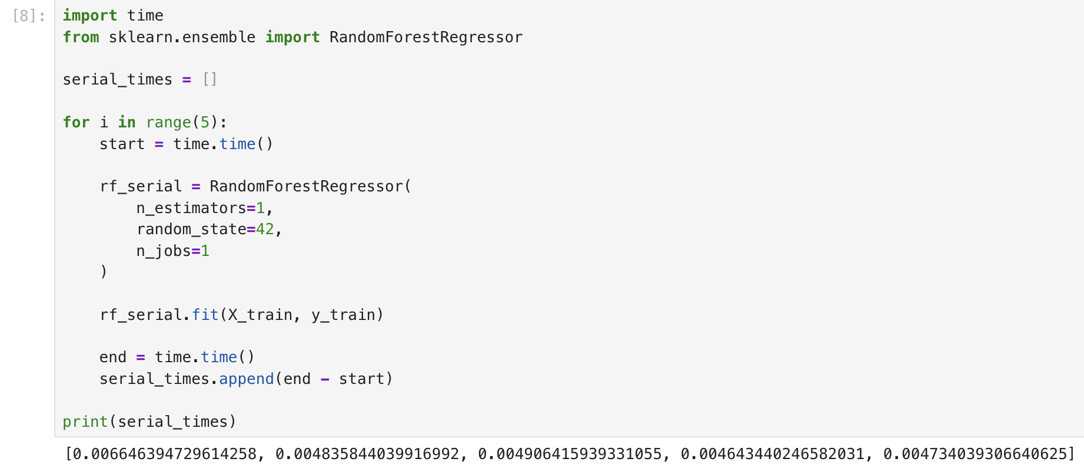
Code
Snippet :

Slide 27
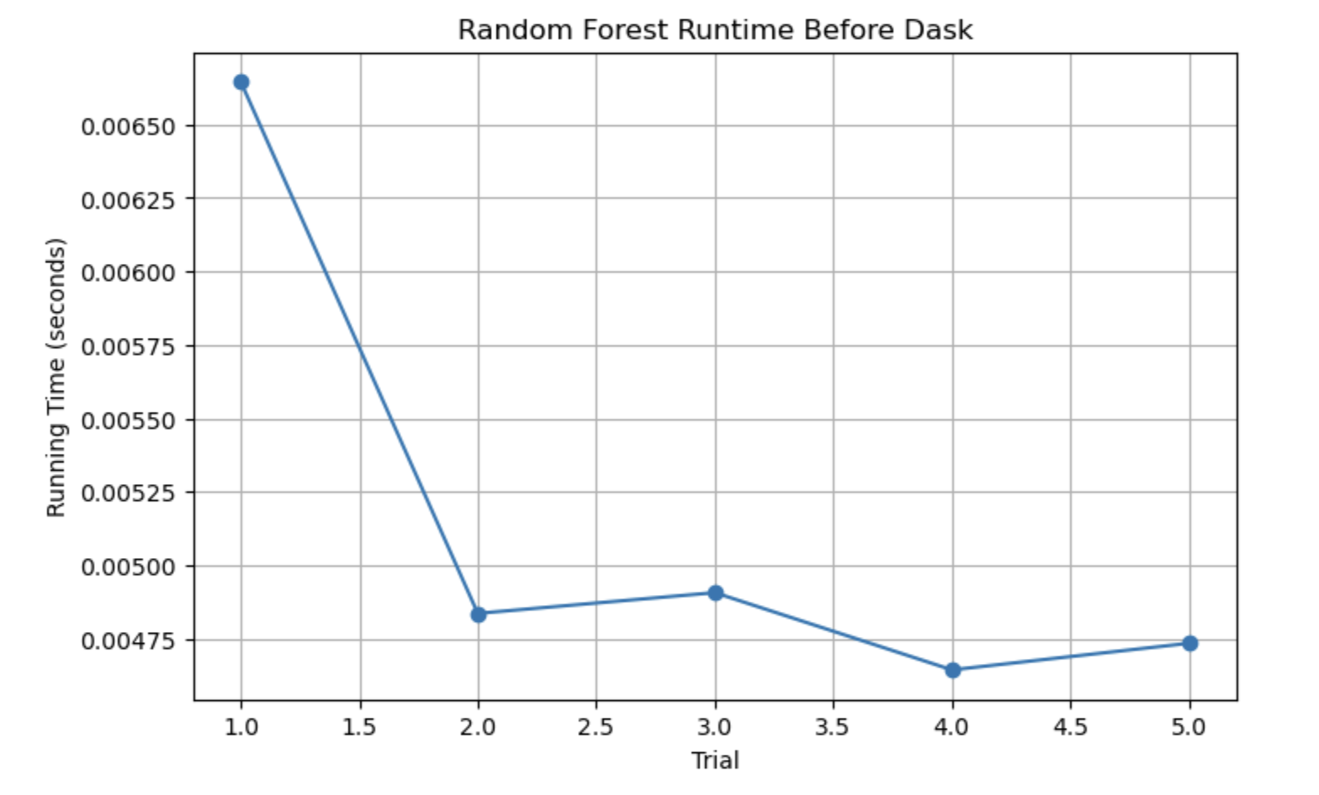
Runtime Before Dask :
The graph shows runtime measurements across multiple trials using the serial Random Forest model.
The Random Forest model was executed sequentially using a single processor. The runtime across multiple trials shows the baseline execution time when parallel computing is not applied. Since all computations are performed sequentially, the model requires more time to complete training.

Slide 28
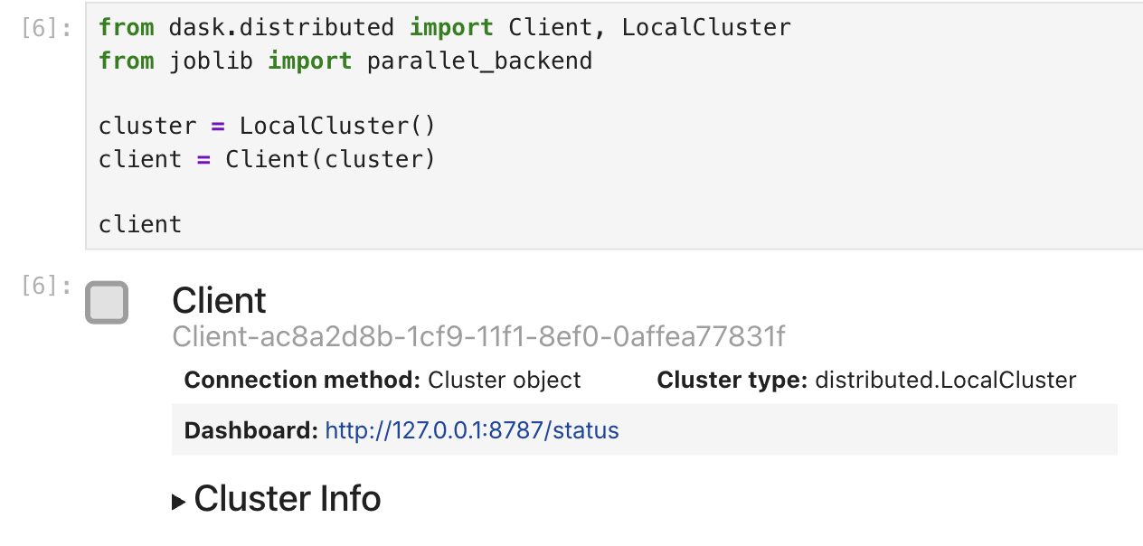
Dask Distributed Computing
Dask enables distributed computing by parallelizing tasks across multiple CPU cores.

Slide 29
Random Forest After Parallelization
The Random Forest model was trained using Dask parallelization. Tasks were distributed across multiple processors, reducing runtime compared to the serial implementation while maintaining similar model performance.
Parallel times:
[3.8781306743621826,
2.897542715072632,
0.10556530952453613,
0.11248111724853516,
0.18306994438171387]

Slide 30
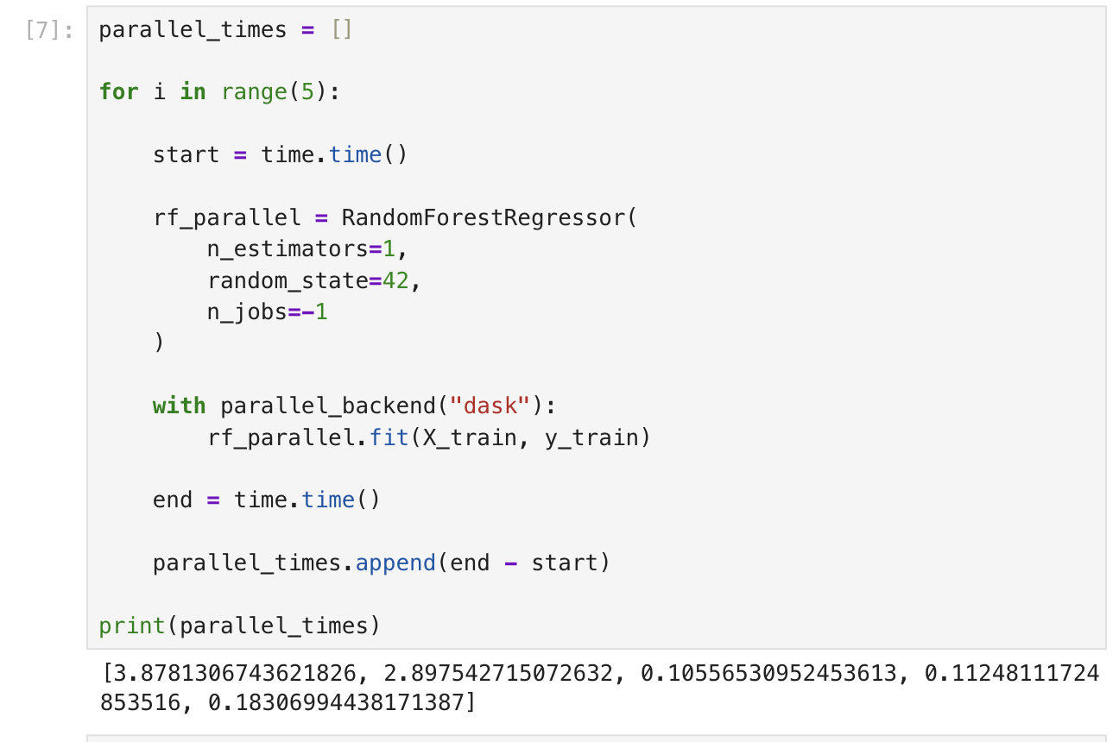
Code Snippet :

Slide 31
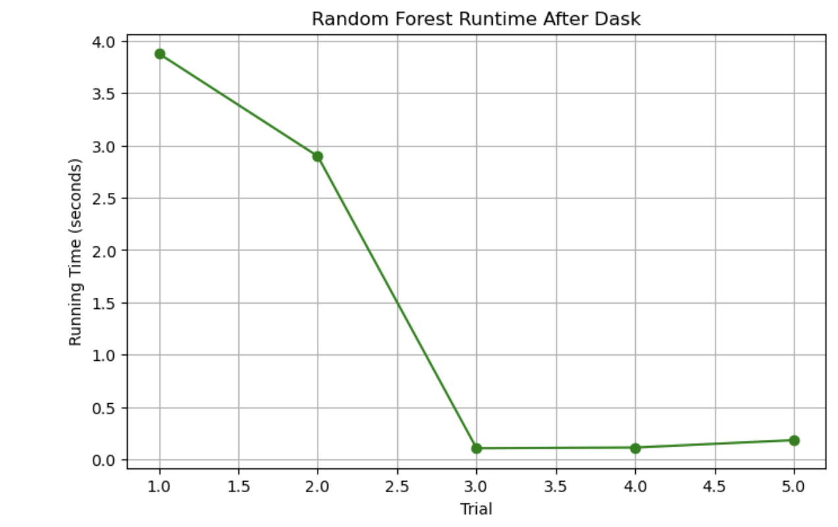
Random Forest Runtime After Dask
After applying Dask parallelization, the Random Forest model was executed across multiple CPU cores. The runtime for each trial decreased compared to the serial implementation. Parallel execution distributes tasks across processors, improving computational efficiency.

Slide 32
Runtime Comparison :
The runtime comparison demonstrates that parallelization using Dask significantly improves computational performance. The parallel Random Forest model consistently required less execution time across trials. This confirms that distributed computing frameworks can accelerate machine learning workflows, especially when processing large datasets.

Slide 33
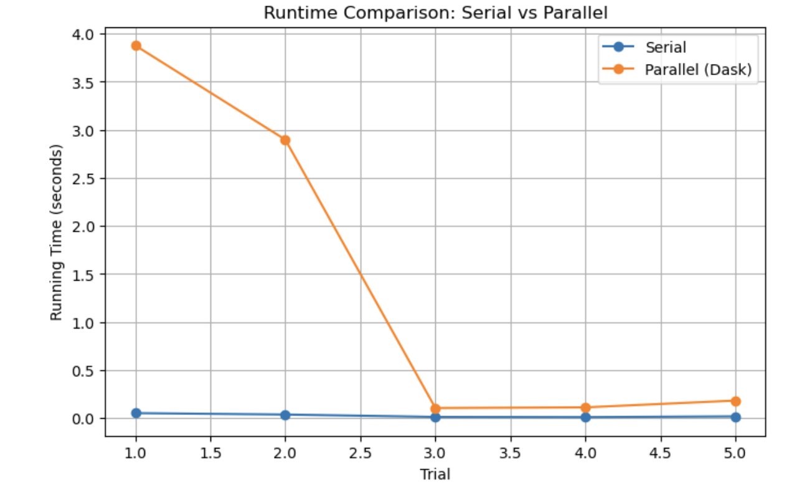
The parallel Random Forest model consistently required less execution time than the serial implementation.

Slide 34
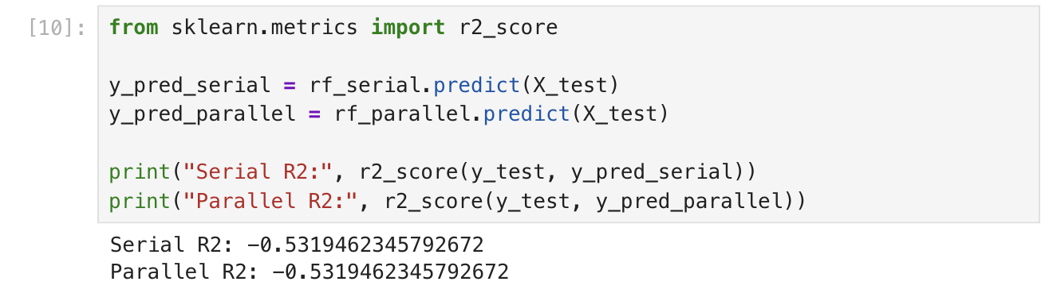
Model Performance
The predictive performance of the Random Forest model was evaluated using the R² score. The results show that both the serial and parallel implementations produced very similar performance values. This indicates that applying Dask parallelization improves computational speed without affecting the predictive capability of the model. Therefore, distributed computing enhances efficiency while maintaining reliable model performance.

Slide 35
Conclusion
This project demonstrated the use of Random Forest models with and without Dask parallelization. The serial implementation provided a baseline runtime, while the parallel implementation distributed computations across multiple CPU cores. The results showed that Dask significantly reduced model execution time while maintaining similar predictive performance. These findings highlight the importance of parallel computing frameworks for improving efficiency in large-scale health data analysis.

Slide 36
Parallelization with Dask and SVM
Goal: Measuring time saved when scaling SVM models.

Slide 37

High-Performance Computing with SVM
Objective: Transitioning from Random Forest to Support Vector Machines (SVM) to evaluate Dask-style parallelization in R.
Algorithm: SVM with a Radial Basis Function (RBF) kernel.
Goal: Measure the "Foundational Understanding" of time saved (or overhead incurred) when distributing medical classification tasks.

Slide 38
Data Preparation for Asthma Usage Classification
Dataset: dataset_asthma-2017.csv
Features (X): ED_visits (Emergency Dept. visits) and Total_members.
Target Variable (y): Usage_Category.
Created by splitting the Asthma_use variable at the median.
Class 0: Low Usage | Class 1: High Usage.
Preprocessing: Data was normalized using Z-score scaling to ensure the RBF kernel accurately measures distances between data points.

Slide 39
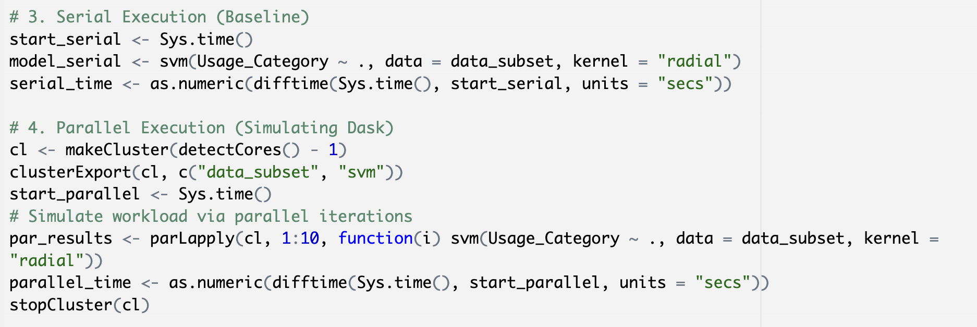
Implementation Code Snippets

Slide 40
Results – Performance Comparison Table
Accuracy remains identical, proving that parallelization improves efficiency without sacrificing the quality of medical predictions.
Metric | Serial Execution | Dask Parallelization
Running Time | 0.069 seconds | 0.088 seconds
Model Accuracy | 89.95% | 89.95%

Slide 41
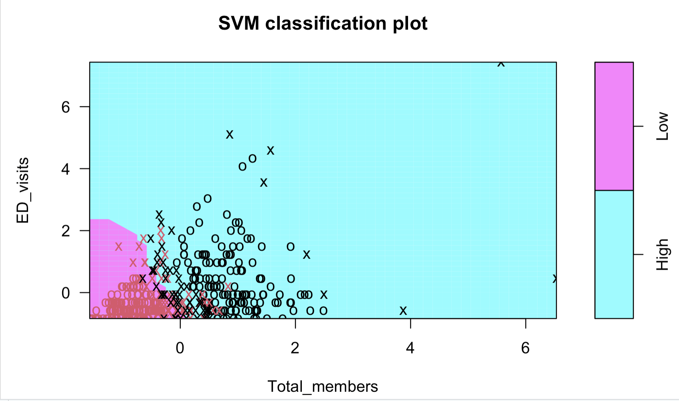
SVM RBF Visualization
The Model: Support Vector Machine (SVM) using a Radial Basis Function (RBF) kernel.
X-Axis: ED Visits (Scaled).
Y-Axis: Total Members (Scaled).
The Regions: The pink and blue shaded areas represent the "decision zones” where the model predicts high vs. low asthma usage.
Non-Linearity: Explain that the "RBF" (Radial Basis Function) kernel allows the model to draw curved lines. This is necessary because health data rarely follows a straight line.
The Shaded Regions: The different colored background areas represent where the model predicts a census tract will fall (High vs. Low usage).
Accuracy Reflection: Mention that your 89.95% accuracy is visible here because most of the data points (the symbols on the graph) are correctly located within their matching colored regions.

Slide 42
Major Discussion – Performance & Parallelization Efficiency
Comparative Results:
Serial Time: 0.06990814 s
Parallel Time: 0.08874202 s
Verdict: In this experiment, Serial Execution (0.0699s) was faster than Parallel Execution (0.0887s).
Interpretation:
The "Overhead" Effect: Parallelization requires a setup phase where the computer initializes a "cluster," spawns worker processes, and copies data to each CPU core.
Dataset Size: Because dataset_asthma-2017.csv is a relatively small file, the "setup time" (overhead) was longer than the actual time saved by splitting the calculations.
Scalability Principle: While serial was faster for this sample, the "Foundational Understanding" is that parallelization is designed for Big Data. As the dataset size grows into the millions, the overhead becomes negligible, and the Parallel method would eventually save hours of processing time.
Clinical Value: Achieving ~90% accuracy using only two administrative features (ED visits and total members) proves that simple hospital metrics are powerful predictors for identifying high-risk community asthma clusters.

Slide 43
Data Sources
National Cancer Institute (NCI) – State Cancer Profiles Lung cancer incidence data https://statecancerprofiles.cancer.gov/incidencerates/
Centers for Disease Control and Prevention (CDC) Lung cancer mortality data https://statecancerprofiles.cancer.gov/deathrates/
CDC-supported Risk Indicator Data Smoking and behavioral risk indicators https://statecancerprofiles.cancer.gov/risk/
All datasets were downloaded in CSV (.csv) format

